Slide 1
Investigation of the correlation between seismic and injection activities in Oklahoma
Kaimin Yue
November 18, 2020

Slide 2
Motivation of the study
Increasing earthquakes reported in Oklahoma since 2009
In the meantime, there is a spike of water injection activities
The objective is to investigate the correlation btw earthquake and injection
Reference: USGS

Slide 3
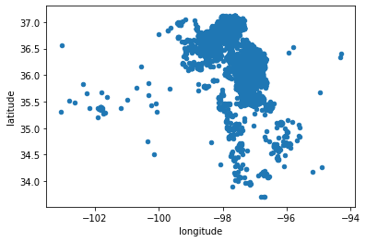
Illustration of earthquake map
Most of earthquakes in Oklahoma in past 10 years occurred in two regions
In the analysis, injection and seismic data are grouped into these two regions
1
2

Slide 4
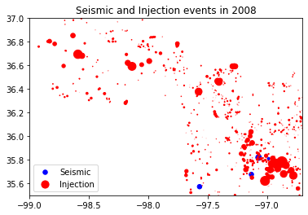
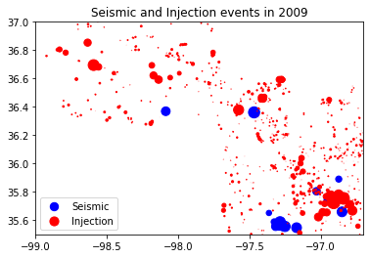
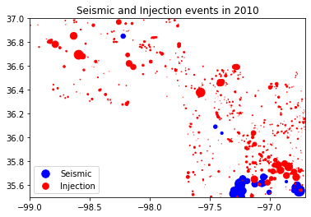
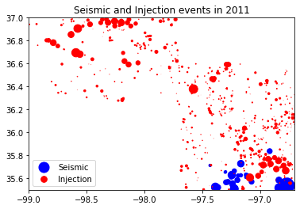
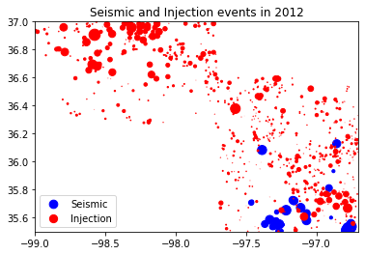
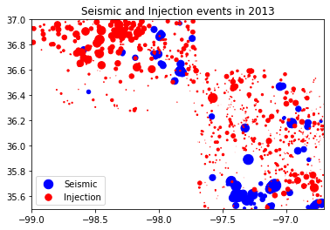
earthquake and Injection map
From 2008 to 2013, seismic activities increase as injection activities increase

Slide 5
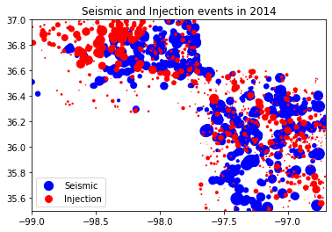
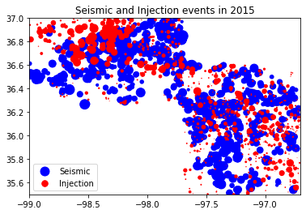
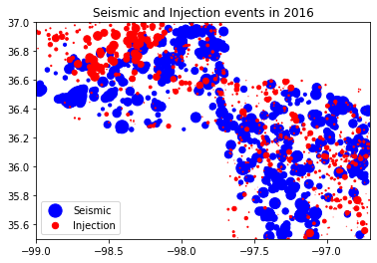
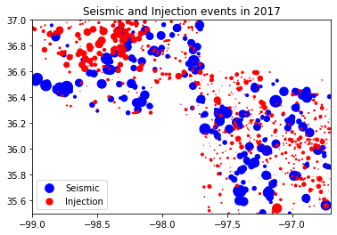
earthquake and Injection map
The seismic activities increase significantly in 2013 compared to years before
The seismic activities decreases as injection decreases between 2015 and 2017

Slide 6
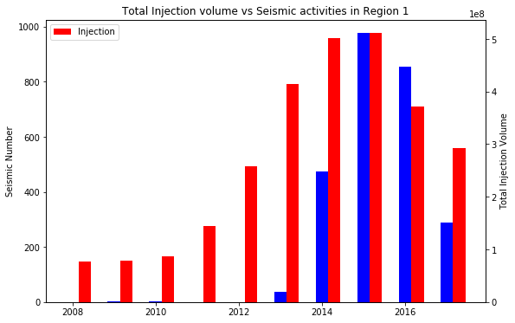
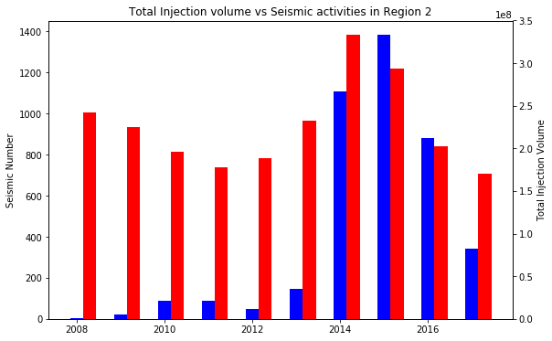
Histogram of earthquake and Injection
In region 1, almost no earthquakes occur before 2013, peaks in 2015, and decreases afterwards.
In region 2, earthquakes dramatically increase in 2014 and decrease after 2015
The plots show some correlation between earthquakes and injection. It requires further statistical analysis to evaluate the correlation

Slide 7
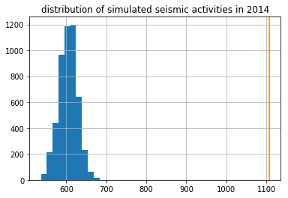
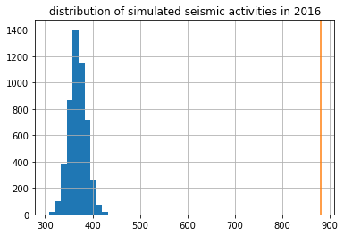
Statistical Interference
The blue bars show the predicted distribution of seismic utilizing the percentage of injection, the yellow line is the real seismic number
Both confidence interval and T-test show that seismic numbers and injection volumes are statistically different

Slide 8
Regression Analysis
LOOCV and Linear Regression and Decision Tree models are utilized
linear regression and decision tree method does not provide good accuracy of the data analysis in this case
 |  |  | MSE | STD
Region 1 | Seis Number vs. Injection volume | Linear Regression | 0.162 | 0.141
 |  | Decision Tree | 0.228 | 0.221
 | Seis magnitude vs. Injection volume | Linear Regression | 0.142 | 0.084
 |  | Decision Tree | 0.206 | 0.134
Region 2 | Seis Number vs. Injection volume | Linear Regression | 0.173 | 0.126
 |  | Decision Tree | 0.153 | 0.126
 | Seis magnitude vs. Injection volume | Linear Regression | 0.060 | 0.036
 |  | Decision Tree | 0.072 | 0.045

Slide 9
Conclusions
Seismic and Injection map as well as the histogram plots show some correlation between seismic activities and injection activities
The statistical interference analysis show that seismic numbers and injection volumes are statistically different
The regression analysis show that it is not accurate to predict the seismic numbers/magnitude based on the injection volume

